Slide 1


Basic Applied Machine Learning
Barry Xue and Garrett Lam
Notes:
Tasks List:
Write out what we want to cover and what we want our presentation to include
I already added some ideas in comments, feel free to add/delete stuff!
Create a public repository with a complete notebook and dataset
Format the slides, add images, and cite all sources
Practice run, comment on the time needed for each slides
First step is probably the hardest, so don’t worry too much about fluidity yet and focus on getting something out. As we finishing up, each following steps should be less and less time consuming.

Slide 2
OVERVIEW
What is Machine Learning?
ML vs Statistical Modeling
Categories of ML
Applications of ML
Life Cycle of a ML Application
Jupyter Notebook Demo
Notes:
What is ML
How is this different from traditional mathematical inferences?
Categories of ML (mention examples)
Supervised
Unsupervised
Reinforcement Learning
Applications of Machine Learning (showcase applications)
Real life scenarios where ML is applied. Ex: netflix recommendation (recommendation system), drug discovery (generative models), google search, tumor imaging detection
ML Life cycle
Models are a small part of building a ML application
Data pipeline, visualization, ml ops

Slide 3
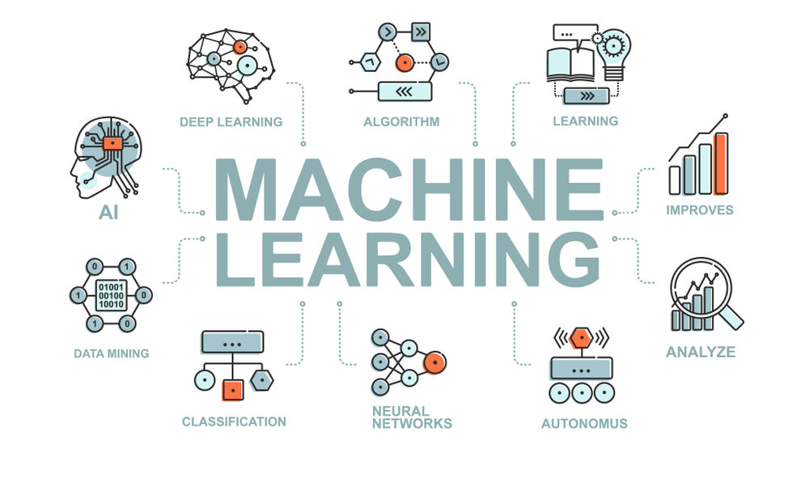
WHAT IS MACHINE LEARNING?
A subfield of artificial intelligence (AI) that utilizes algorithms and data to learn, make predictions, and generate insights without explicitly programming it to do so
Notes:
What is ML
How is this different from traditional mathematical inferences?
Categories of ML (mention examples)
Supervised
Unsupervised
Reinforcement Learning
Applications of Machine Learning (showcase applications)
Real life scenarios where ML is applied. Ex: netflix recommendation (recommendation system), drug discovery (generative models), google search, tumor imaging detection
ML Life cycle
Models are a small part of building a ML application
Data pipeline, visualization, ml ops

Slide 4
MACHINE LEARNING VS STATISTICAL MODELLING
Statistical Modelling: formalizing a mathematical relationship between one or more random variables in the form of a mathematical equation
Machine Learning | Statistical Modeling
Makes less/no assumptions about data | Mathematically based, many assumptions must be made about data
Can use a large range of datasets (big data) | Limits to small datasets (cannot have too many attributes/features)
Streamlining the training process with algorithms | Focus on model explainability
Goal: strong predictive ability + usability | Goal: best estimate of data
Notes:
Credit card example

Slide 5
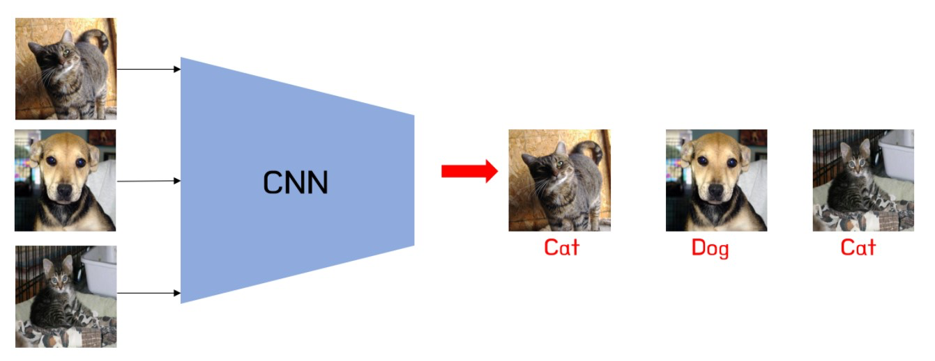
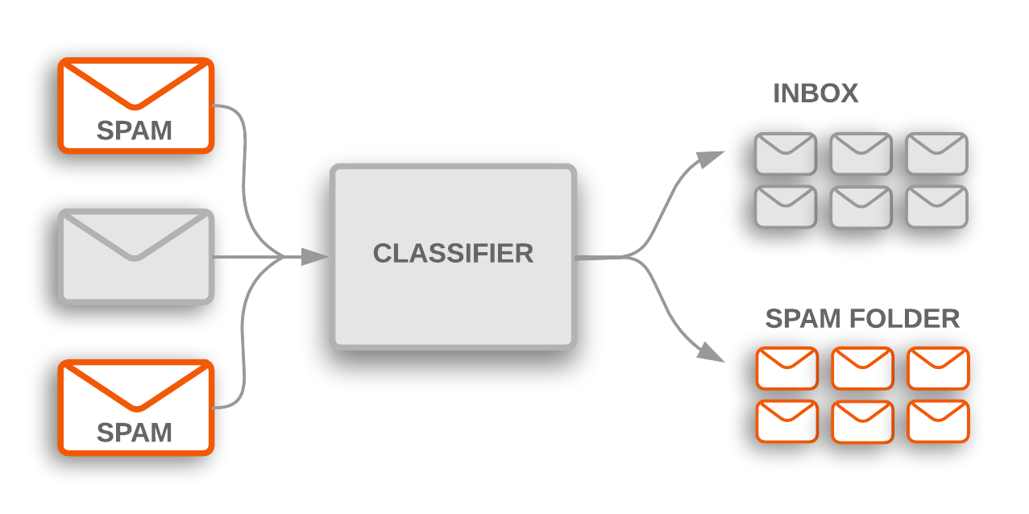
CATEGORIES OF MACHINE LEARNING
1. Supervised Learning
Uses a trained dataset to train an algorithm into classifying data or predicting outcomes accurately
Training and testing data is given
Goal: extrapolate knowledge learned from training data to the testing data
Classification is a supervised learning task, examples include:

Slide 6
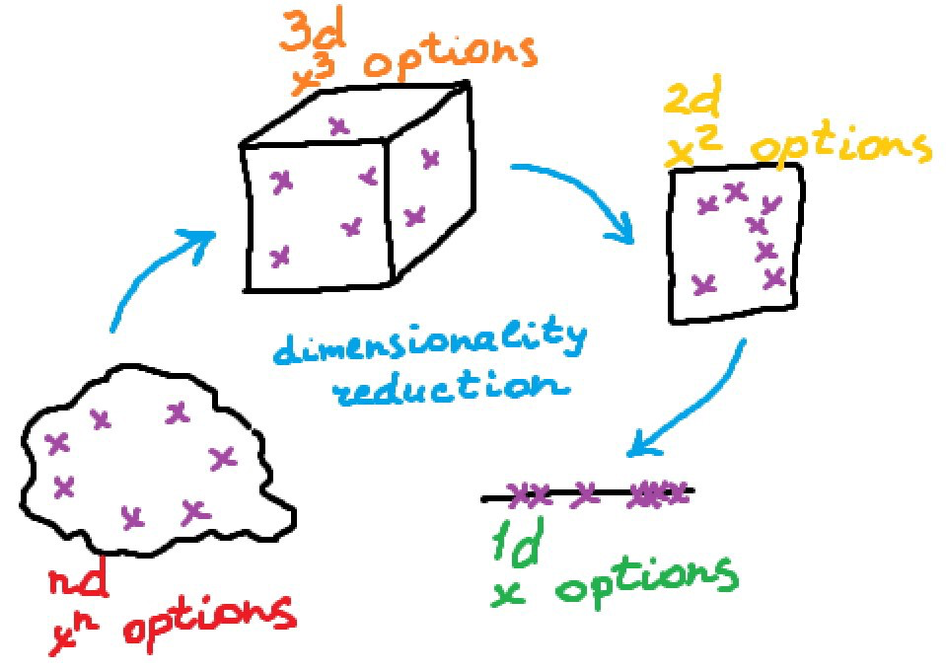
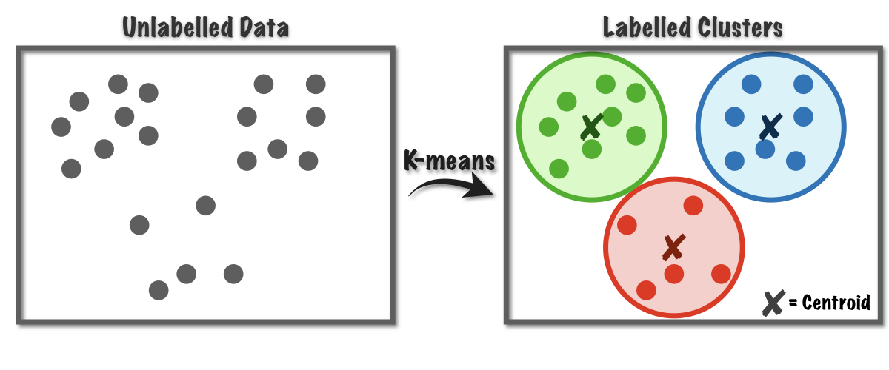
CATEGORIES OF MACHINE LEARNING
2. Unsupervised Learning
Uses generic machine learning algorithms to analyze and discover hidden patterns in data
Only testing data is given
Goal: learn patterns and rules about the testing data
Clustering is an unsupervised learning task, examples include:

Slide 7
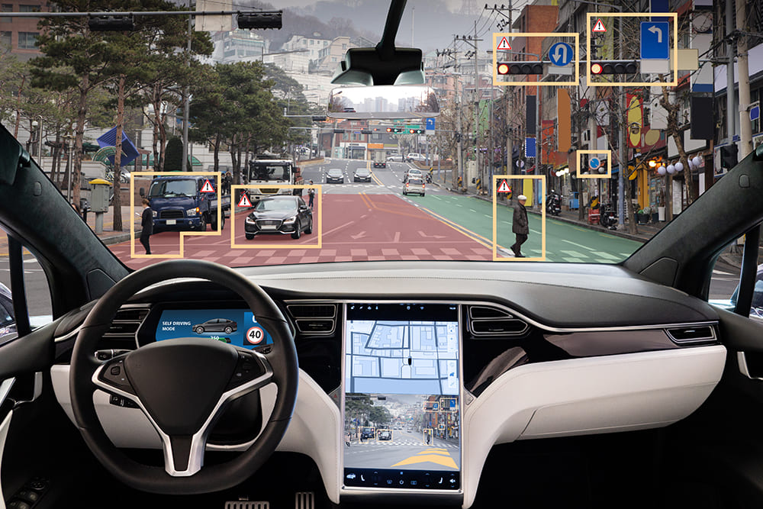
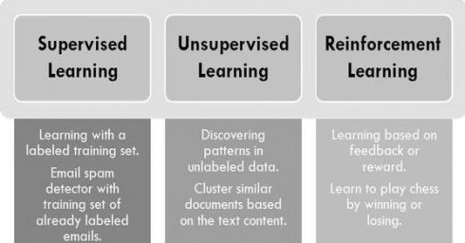
CATEGORIES OF MACHINE LEARNING
3. Reinforcement Learning
A technique that utilizes an agent to learn in an environment by using positive and negative feedback from its own actions and experiences
Goal: discover actions that maximizes reward of the agent

Slide 8
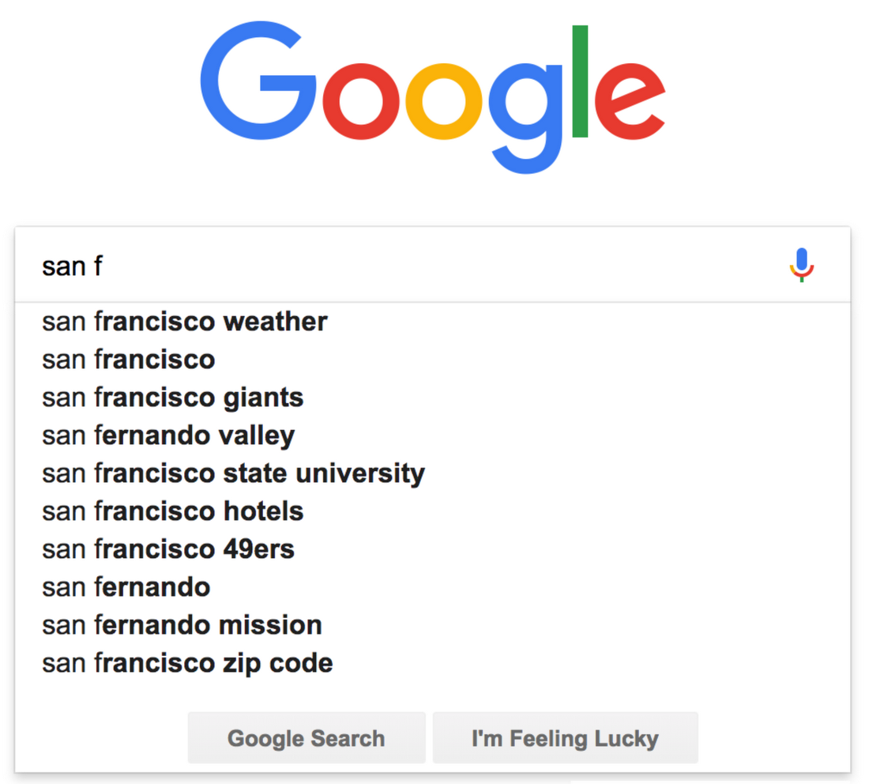


APPLICATIONS OF MACHINE LEARNING
Netflix Recommendations (Recommender Systems)
Google Search (Natural Language Processing)
Facial Recognition (Computer Vision)
Notes:
Separate slides
Netflix: Recommender systems
What is the model they use to recommend thousands of movies, tv shows
Google search and chatgpt (GPT): natural language processing
Name of model, what it does
Facial recognition - Snapchat , face ID, Dall-E (diffusion models)
Source: Snap Engineering Blog
Drug discovery
Source: Machine learning powers biobank-driven drug discovery | Nature Biotechnology

Slide 9
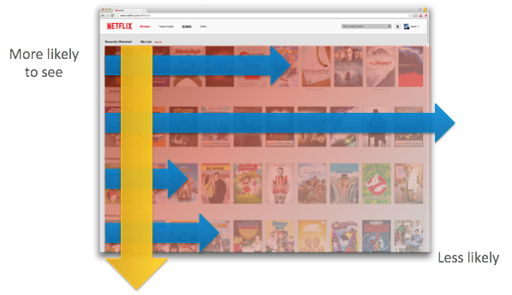
NETFLIX RECOMMENDATIONS
Netflix uses the Netflix Recommendation Algorithm (NRE) to automate recommendations for users:
Combination of multiple ML algorithms
Two-tiered row based ranking system
Data used:
Most viewed genres
Rewatched titles
User ratings (Thumbs up/down)
“My List” section
Viewing habits
Notes:
NRE
Multiple algorithms:
Reinforcement learning
Neural Networks
Matrix Factorization

Slide 10

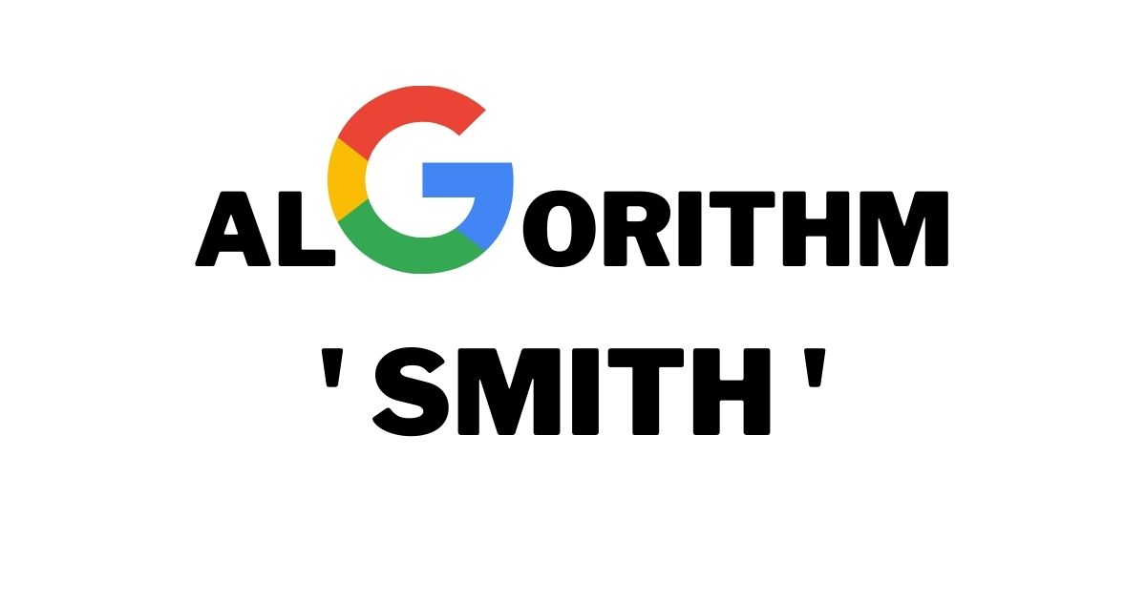
GOOGLE SEARCH
Google uses transformer based architecture neutral networks called Bidirectional Encoder Representations from Transformers (BERT), and more recently Siamese Multi-Depth Transformer-based Hierarchical (SMITH) Encoder
Both NLP algorithms: BERT short queries, SMITH long queries
Uses semantics, word segmentation, most popular global searches, and browsing history
Notes:
While you are typing your google search, they will use semantics, word segmentation, most popular global searches, and browsing history to determine what you are trying to search for

Slide 11
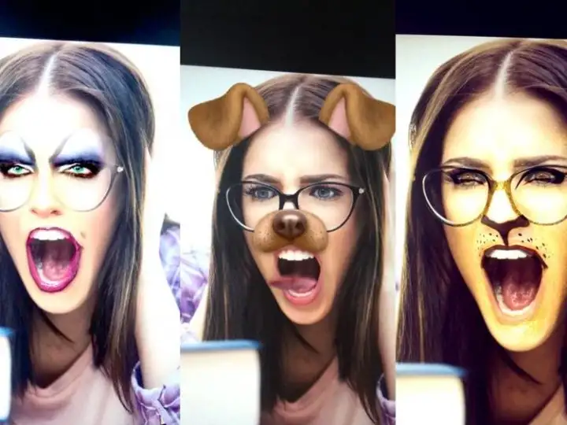
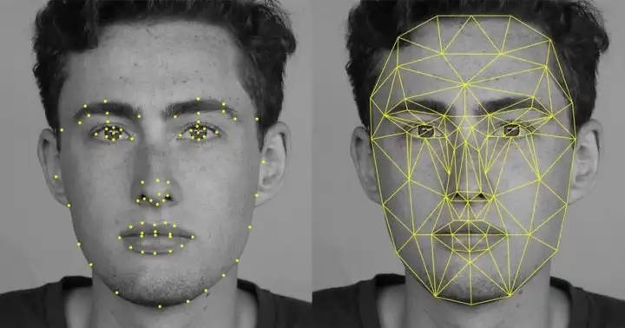
SNAPCHAT FILTERS
Snapchat uses face detection, facial landmarks, and image processing to produce filters
Face Detection: Support Vector Machine (SVM)
Facial Landmark: Regression Trees
Image Processing: Active Shape Model
Notes:
For face detection, snapchat uses the support vector machine (ML technique) to map your facial structure in the form of x,y coordinates with width and height
For facial features, snapchat uses regression trees to map the x,y coordinates of your facial features
For applying filters, snapchat uses the active shape model that creates a mesh (3D model) around your face to apply the filter

Slide 12
“Models are a small part of building a ML application”
Notes:
The three categories of ML mentioned earlier are the main ways a machine learning model can be trained. Although training a model is quite exciting, we would like to just remind you that “models are only a small part of building a ML application or project”. There are many others stages before and after the model building process that are important for a ML application or project to be successful, these processes include: data collection, data wrangling, data visualization, model testing, and parameter tuning

Slide 13
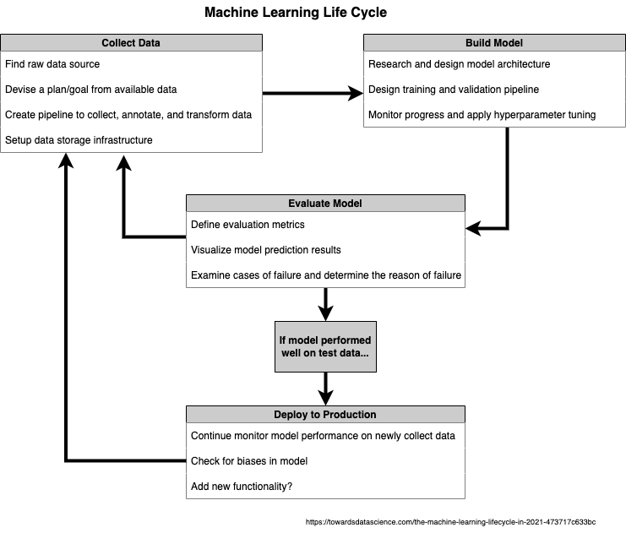
Notes:
Data Collection (Web Scraping)
Find data source,
Plan how to utilize data
Data Preparation/Wrangling
Manually clean up data, removing unnecessary features, missing values etc
Choosing a Machine Learning Model to use
Training Machine Learning Model using Training Data - 80% training, 20% testing split
Evaluate Machine Learning Model on Testing Data
Deployment of ML Model OR Retraining Data (parameter tuning)
Integrate the ML model into your application
Retrain on newly collected data

Slide 14
DEMO
Notes:
Regression: Stock price prediction - time series prediction
Classification: Handwritten digits classification - image classification
Clustering: Anomaly detection
Competition: cat and dogs - image classification

Slide 15
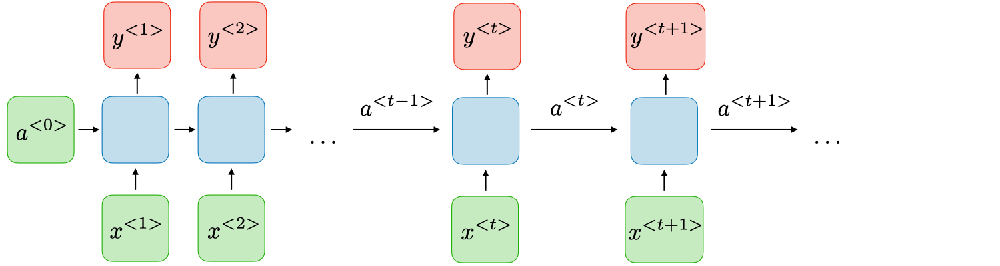
Stock Market Trend Prediction
Objective: Using the Moving Average and a LSTM RNN model to predict a stock’s closing prices.
What you will learn:
Moving average filter
Recurrent Neural Network
Long short-term memory (LSTM)
Source: Stanford CS 230 Lecture Note

Slide 16
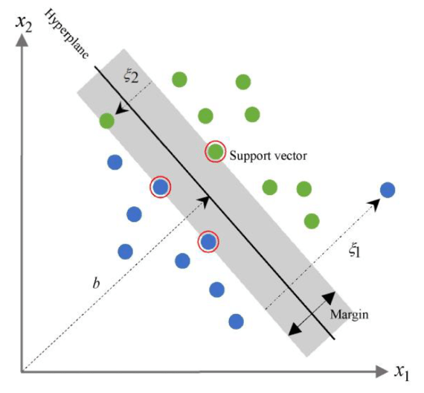
Handwritten Digits Classification
Objective: classify pictures of handwritten digits (0-9) using classic ML techniques.
What you will learn:
Simple practice of image processing
Support Vector Machine (SVM)
Convolution Neural Network (CNN)
Source: ResearchGate - SVM

Slide 17
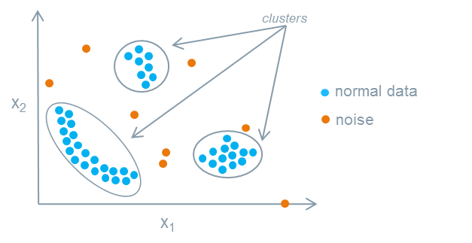
Anomaly Detection
Objective: find abnormal data points given a noisy dataset.
What you will learn:
K-means Clustering
Density-based clustering technique (specifically, DBSCAN)
Source: Siemen’s MindSphere Documentation

Slide 18
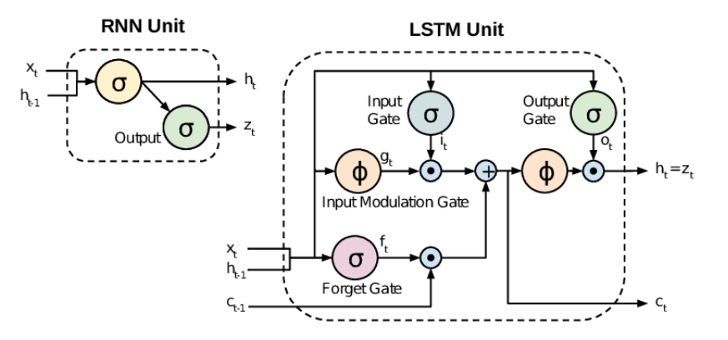
Appendix A.1: RNNs and LSTM
A RNN cell recurrently updates its hidden weights ( a(t) ) with each iteration of new input data ( x(t) ).
Traditional RNN has some known issues:
High computation cost and long runtime
Vanishing gradient after long sequence of updates

Slide 19
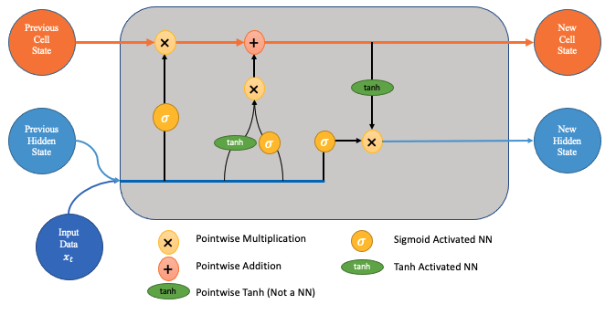
Appendix A.2: RNNs and LSTM
LSTM is a RNN unit designed to fix those issues. It uses three gates:
Forget Gate
Keep Gate (Input Gate)
Output Gate
The gating mechanism allows a chain of LSTM cells to:
Skip input at specific time step
More expressive with longer sequences, less likely to suffer from vanishing gradient

Slide 20
Appendix B: Support Vector Machine
Support Vector Machine aims to maximize the margin between the closest data points, with an allowed error rate.
The points circled in red are the ‘support vectors’ that define the margin size.
The green data point is on the incorrect side of the hyperplane, but it is within the allowed error rate.
This helps the model generalize.

Slide 21
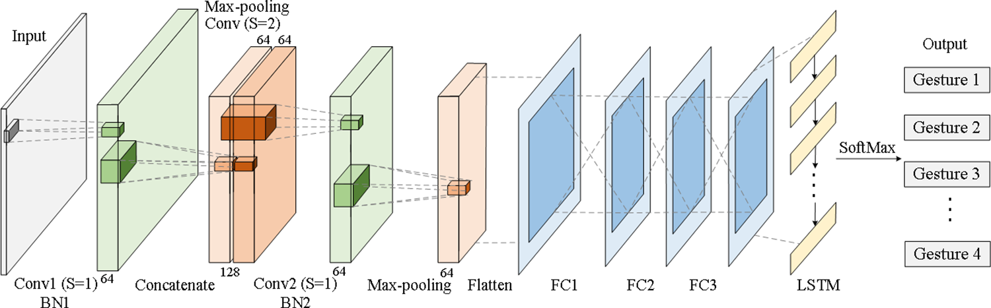
Appendix C: CNNs
Convolution Neural Network has three essential components:
Convolutional layers
Pooling layers
Non-linear activation
Other components:
Dropout layer
Normalization Transformation
Additional model (LSTM, MLP, etc)

Slide 22
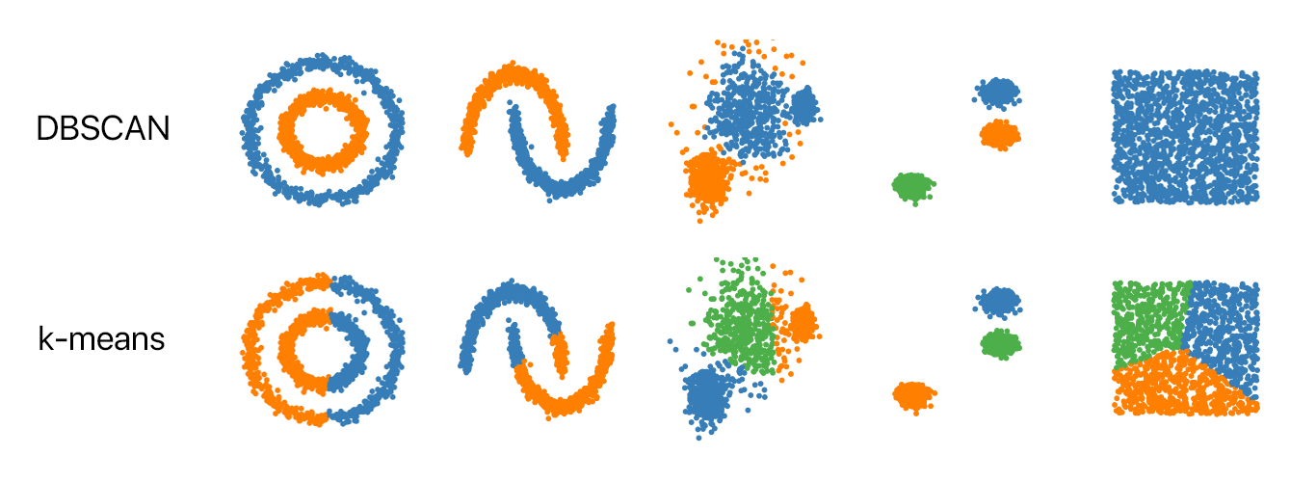
Appendix D: DBSCAN
Uses a density-based approach to search for cluster
With a given radius of each point, and iteratively move from point-to-point
This is different from kmeans, because:
No fixed number of cluster
More geometrically flexible

